Slide 1
Kindle II Project
Caitie Fleckenstein, Leisel Martig, Brittany Pollack, Leah Ritter,
Hope Schrott, Jess Stearns, Julia Trombetta
Advisors: Dr. Amy Camardese & Dr. Eileen Morelli

Slide 2
Overview
Middle School in Northeastern Ohio
Grades 6-8
60 students with Individualized Education Plans (IEPs)
  30 without Kindles
  30 with Kindles
All with IEPs in reading comprehension and fluency

Slide 3
Research Questions
Will the Kindle improve reading comprehension for students with disabilities?
Will the Kindle improve fluency for students with disabilities?
What are the benefits of incorporating e-readers into a reading program for students with disabilities?

Slide 4
Methodology
All students were to read 90 minutes per week / 720 minutes total
12 week duration
Students logged reading minutes
Read on the independent reading level based on results of the Jerry Johns Basic Reading Inventory
Progress measured over time (4 probes)

Slide 5
Baseline Testing
Basic Reading Inventory developed by Jerry L. Johns was given to each student
To determine the starting point of the basic reading inventory teachers indicated a baseline reading level
The test consisted of:
  A story read aloud
  Tracked miscues
  10 comprehension questions

Slide 6
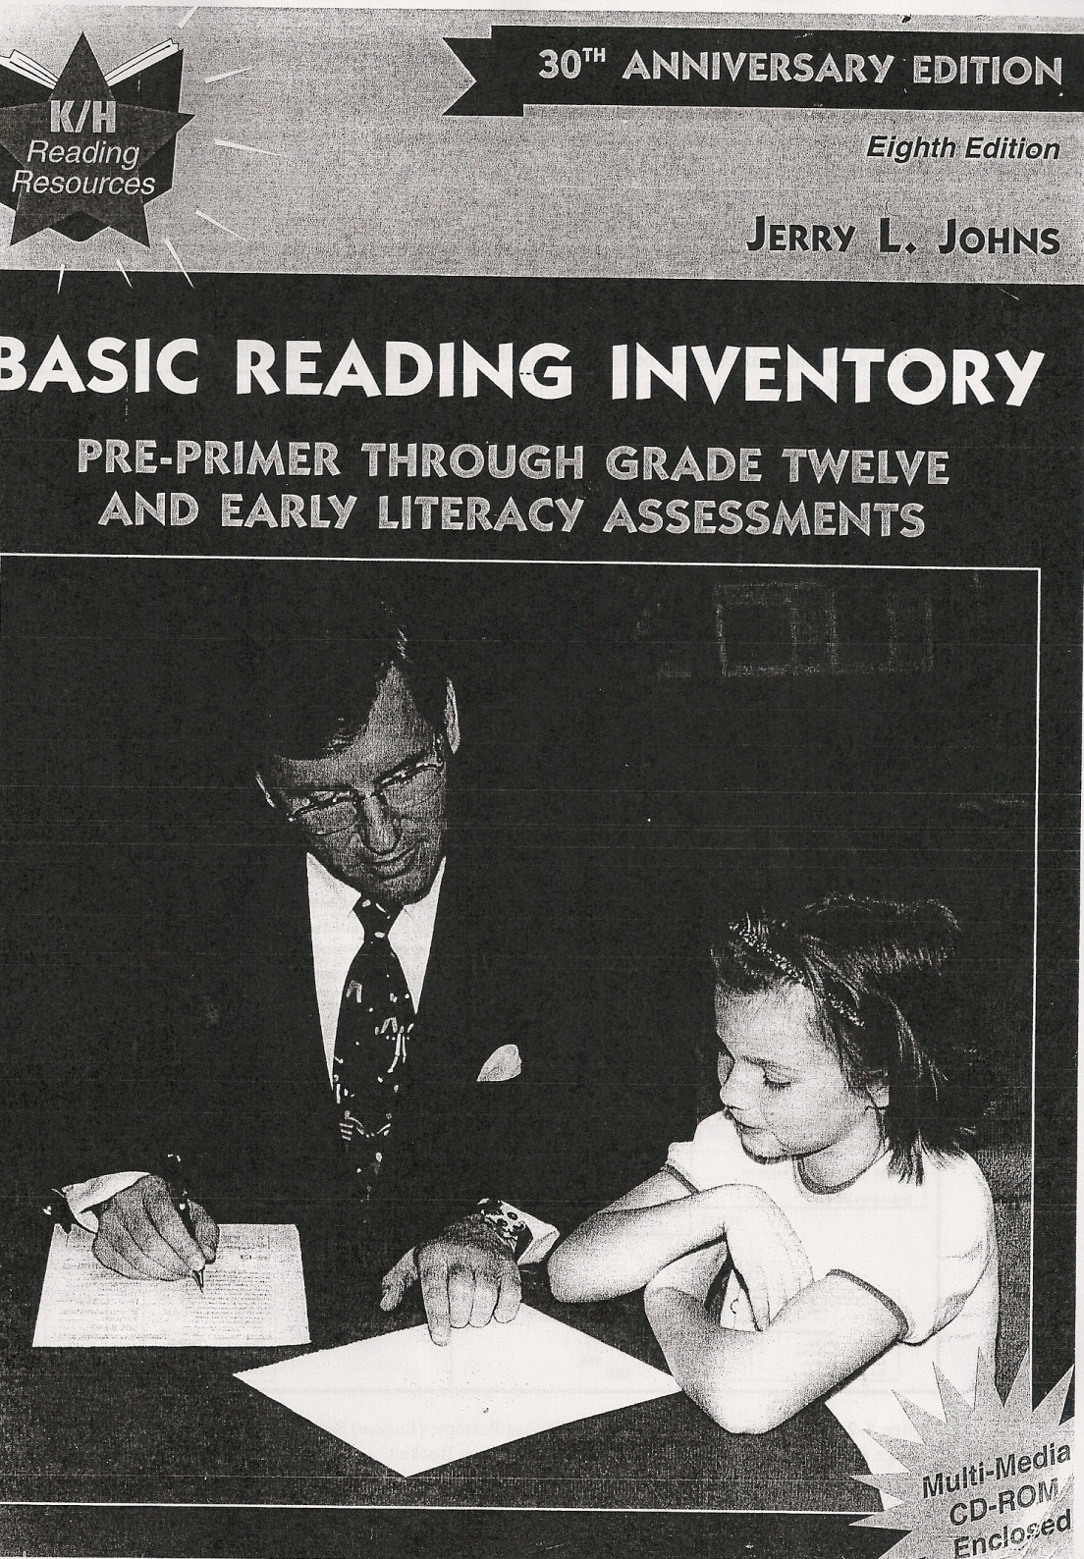

Slide 7
Control Group
(No Kindle Group)
30 students
Grades 6-8
Students read books at their independent reading level
The students read in self-contained settings during their resource time
Students logged their reading minutes

Slide 8
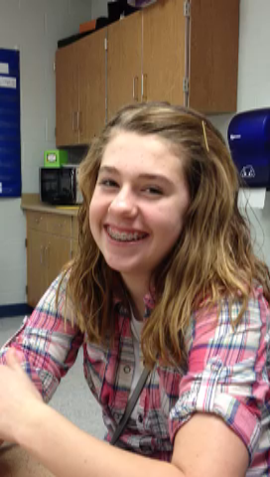
Control group
“I liked being a part of something to see if we should still be reading books or kindles”
“Being able to picture the story in my head”

Slide 9
Experimental Group
(Kindle Group)
30 students
Grades 6-8
Reading with Kindles in order to utilize its many features such as:
  Dictionary
  Text to Speech
  Enlarged Print
  Highlighting
Read books at student’s independent level on Kindle
Students read in a self-contained setting during resource time
Students logged reading minutes
Notes:
Text-to speech, enlarged text, highlighting, dictionary

Slide 10
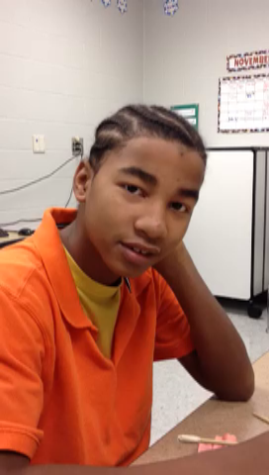
Experimental group
“When I didn’t know it told me the definition and how to pronounce them. The Kindle also read to me.”
“Pretty much nothing at all.”

Slide 11
Kindle II Project
Findings
Notes:
Text-to speech, enlarged text, highlighting, dictionary

Slide 12
Results-Independent Level
Kindle/No Kindle | Mean | Standard Deviation
Kindle No Kindle Total | 3.3226 3.2414 3.2833 | 1.55750 1.84498 1.68836
Kindle No Kindle Total | 3.9355 4.0690 4.0000 | 1.98218 1.48639 1.74667
Kindle No Kindle Total | 4.1935 4.1034 4.1500 | 1.90472 1.81944 1.84873
Kindle No Kindle Total | 4.6129 4.6207 4.6167 | 2.72858 2.27429 2.49808

Slide 13
Results-Instructional Level
Kindle/No Kindle | Mean | Standard Deviation
Kindle No Kindle Total | 4.2903 4.1034 4.2000 | 1.69693 2.25745 1.97269
Kindle No Kindle Total | 5.0323 5.2414 5.1333 | 2.12107 1.66165 1.89975
Kindle No Kindle Total | 5.2903 5.1034 5.2000 | 2.16323 2.22558 2.17692
Kindle No Kindle Total | 5.3548 5.5690 5.4583 | 2.99498 2.69167 2.83036

Slide 14
Results-Frustration Level
Kindle/No Kindle | Mean | Standard Deviation
Kindle No Kindle Total | 5.2581 5.0345 5.1500 | 1.87914 2.54225 2.20804
Kindle No Kindle Total | 6.0000 6.6897 6.3333 | 2.39444 1.71346 2.10461
Kindle No Kindle Total | 5.9355 6.1379 6.0333 | 2.37957 2.46003 2.40033
Kindle No Kindle Total | 5.9032 6.3448 6.1167 | 3.18700 2.88191 3.02583

Slide 15
Kindle II Project
Additional Findings

Slide 16
Kindle II Project
Minutes Read
Control Group (Non Kindle)
Experimental Group (Kindle)

Slide 17
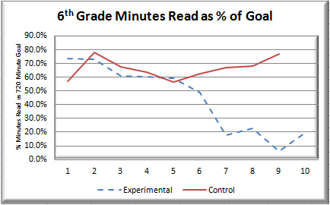
Comparison of Kindle Utilization

Slide 18
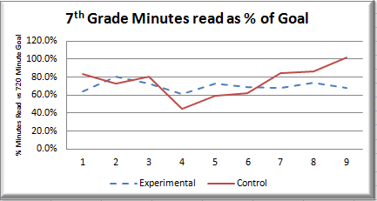
Comparison of Kindle Utilization

Slide 19
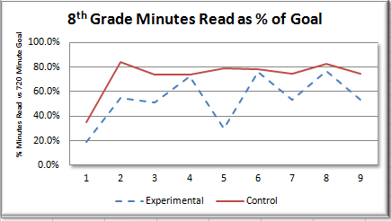
Comparison of Kindle Utilization

Slide 20
Kindle II Project
Pre-Assessment
Student Survey

Slide 21
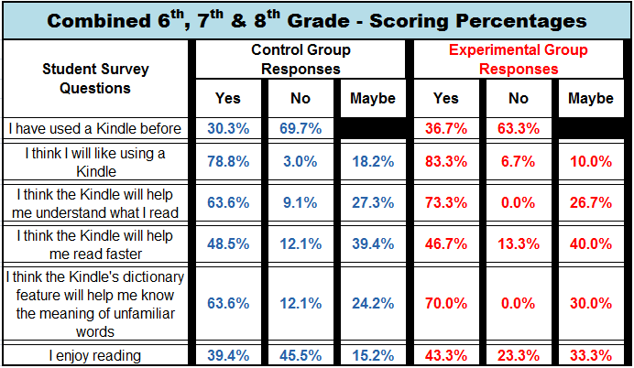
Kindle II Project
Pre-Assessment Student Survey

Slide 22
Kindle II Project
Post-Assessment
Student Survey

Slide 23
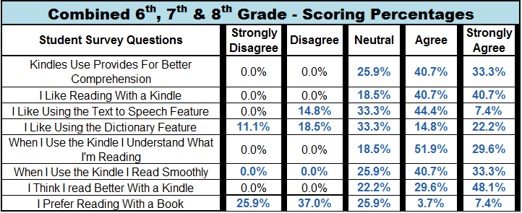
Kindle II Project
Post-Assessment Student Survey

Slide 24
Kindle II Project
Pre-Assessment
Teacher Survey

Slide 25
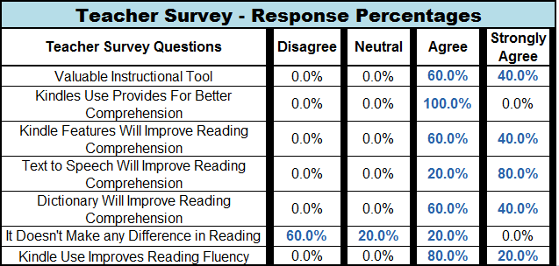
Kindle II Project

Slide 26
Something to think about
APPROPRIATE READING LEVEL
REQUIRED READING TIME
PROGRESS MONITORING
MOTIVATION

Slide 27
IMPLICATIONS
  FINANCIAL CONSIDERATIONS FOR SCHOOLS

Slide 28
Kindle II Project
Conclusions
Quotes: “It tricked me into reading”
Pre-Service Teacher Learning Experiences:
Questions?

